Slide 1
DKTE Society's Textile & Engineering Institute (An Autonomous Institute) Countdown Timer using Python Electronics and Telecommunications B. Tech. Third Year
Sourabh Jaykumar Patil

Slide 2
CONTENT
Introduction
Requirements
Flow Chart
Advantages
Disadvantages
Applications
Conclusion

Slide 3
INTRODUCTION
This Python project is used to set a countdown timer.
It displays how much time is left in your set time.
It is like an alarm that will give the user options to set the time and
when that time will over it will notify the user.

Slide 4
Requirements
Importing Required Module
Create a Display Window
Create Function to Start Timer
Create Button

Slide 5
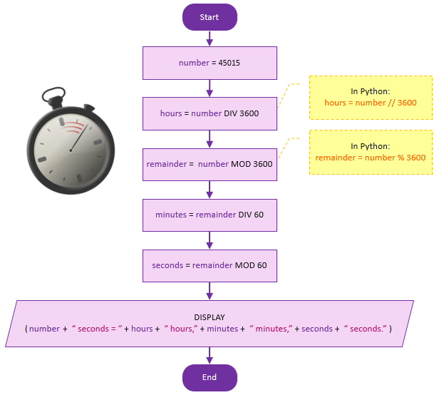
Flow Chart

Slide 6

Advantages
It Creates a Sense of Urgency
Pushes Users to Make there work
Highlights a available time

Slide 7

Disadvantages
not conscious about the year , month, week days.
not conscious about day time and night time.

Slide 8

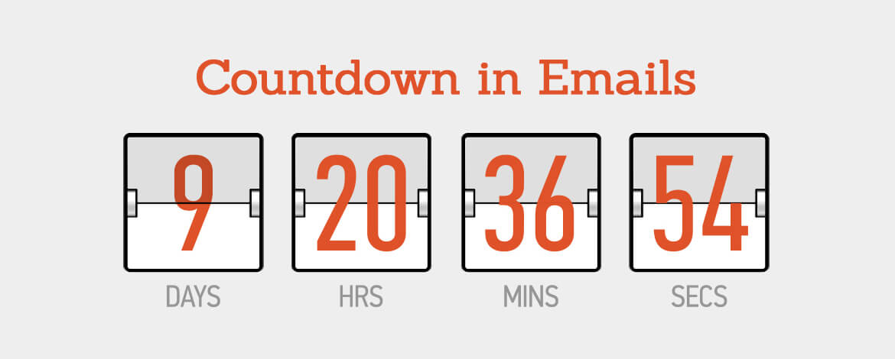
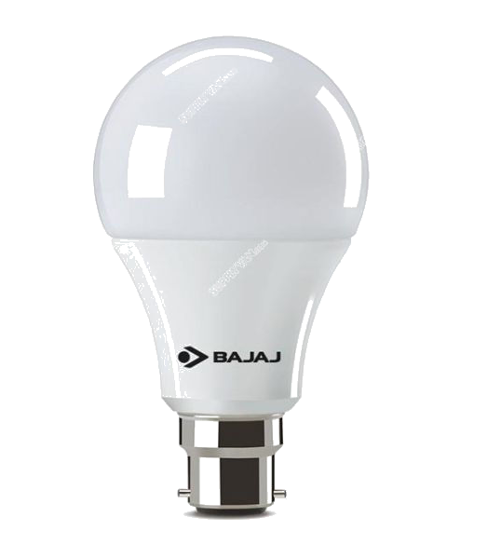
Applications
Application 1
Application 3
Application 2
In Email Marketing
Use to Website Pages
Myntra
Amazon
Flipkart
Ajio
Before Starting Sports

Slide 9

Conclusion
Python Countdown Timer can be utilized to wait for a certain duration of time in the idle state before reiterating the same piece of code in the loop again as required.
Python’s time library contains a predefined sleep() function.
The “duration” for which we want to delay the execution is passed as an argument to the sleep() function in seconds.
This function, in combination with a loop, serves as the Python countdown timer.

Slide 10

THANK YOU!

Slide 11
ANY QUESTIONS
?

